Slide 1
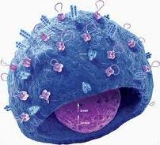
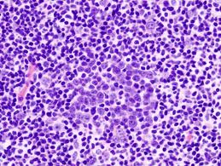
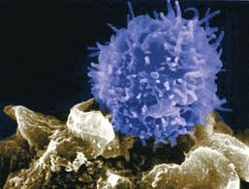
  Infectious Diseases
  Lesson 5.3

Slide 2
Lesson Objectives:
After finishing today’s lesson, you will be able to:
explain clonal expansion.
describe the three ways antibodies inactivate pathogens.
explain T killer cells responses.
explain T helper cell responses.

Slide 3
Do Now
    Have you ever felt clonal expansion?
      Hint: if you have a sore throat your doctor
      might feel your …?

Slide 4
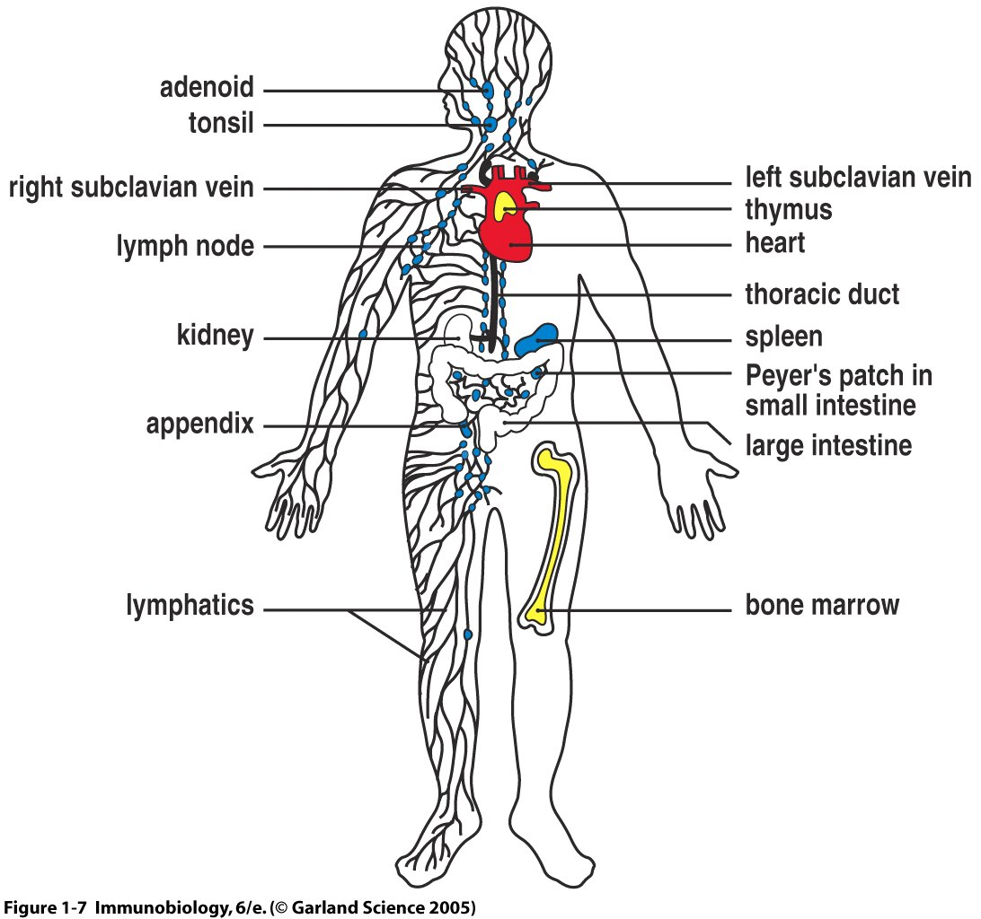
Clonal expansion takes place in the lymph nodes
This takes 10–12 days!

Slide 5
Discussion: A clone of B cells responds in two ways
1) They become effector cells and release antibodies that stop microbes
2) They become memory cells and can wait for their pathogen for years
Memory B and T cells are the key to vaccination!

Slide 6
Antibodies stop infections in three main ways
1
2
3
Notes:
Explain the words neutralization and agglutination.

Slide 7
So far we have focused on B cells.
Now lets see how T cells recognize and respond to a pathogens!

Slide 8
T cells cannot ‘see’ a pathogen on their own
T cells need to be introduced to pathogens by
antigen-presenting cells.

Slide 9
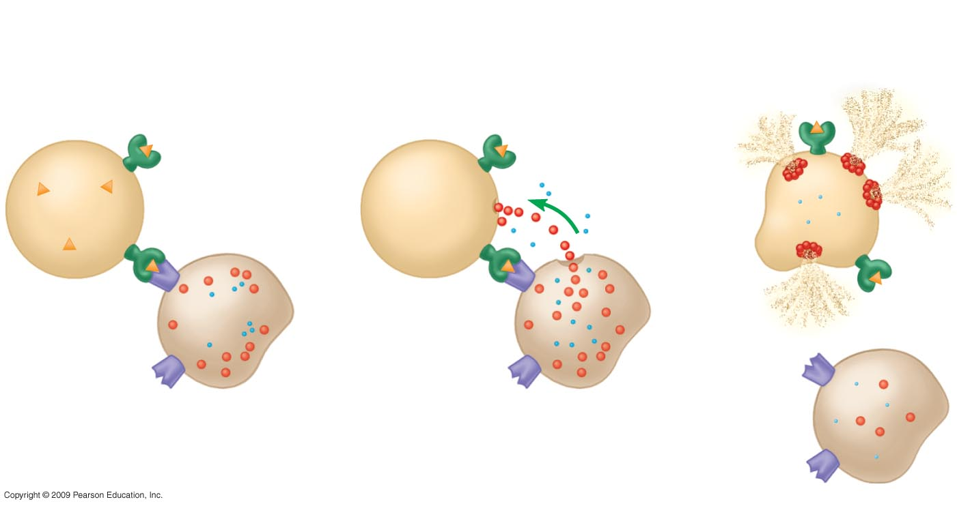
Killer T cells kill infected host cells
3. These enzymes force the infected cell to commit suicide
1. Killer T cells recognize the foreign antigen on the infected cell
2. Killer T cells release
Enzymes
enzymes
Infected cell
Killer
T cell

Slide 10
Helper T cells activate effector B cells and T killer cells with cytokines
B cell
Antibodies and B cell memory
T cell
receptor
Cytokines
activate B cells
and other T cells
7
Helper
T cell
Cytokines
stimulate
cell division
Killing of infected host cells and memory
Cytotoxic
T cell

Slide 11
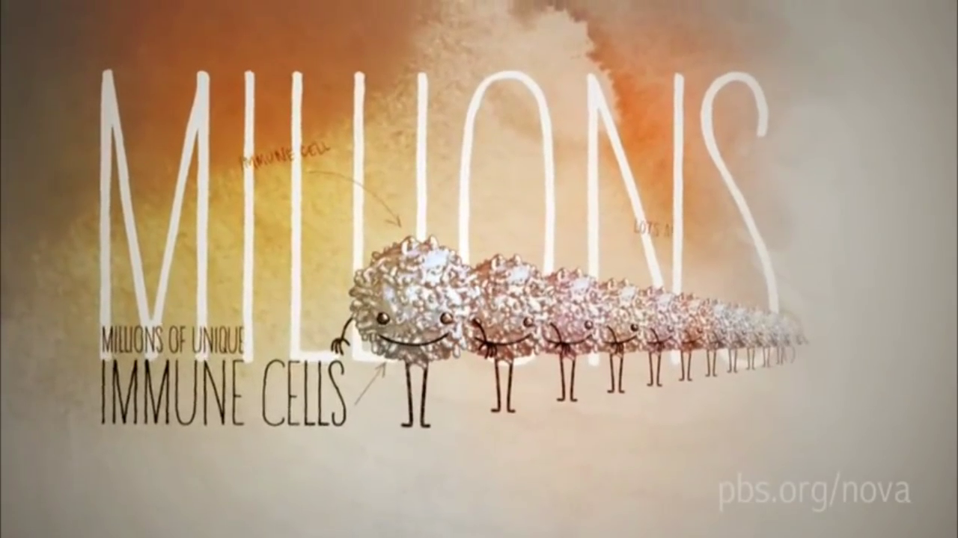
Wrap Up

Slide 12
Wrap Up
B cells make antibodies:
    Clump the pathogens and neutralize them.
    Increase phagocytosis of the pathogens.
    Enhance the function of the complement.
T cells:
    Killer T cells kill infected host cells.
    Helper T cells help other T cells and B cells to function.

Slide 13
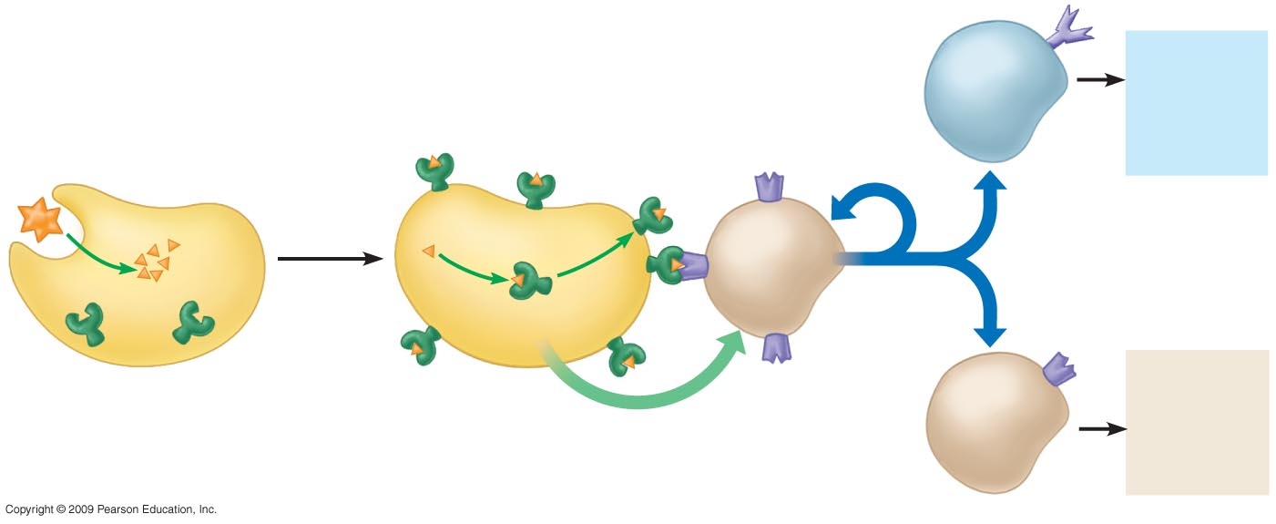
Wrap Up:
Putting it all together
Antibodies and B cell memory
Self-nonself
complex
B cell
T cell
receptor
Cytokines
stimulate
cell division
Microbe
Macrophage
3
5
6
Cytokines
activate B cells
and other T cells
2
Helper
T cell
1
4
7
Self protein
Killing of infected host cells and memory
Antigen from microbe
(nonself molecule)
Antigen-presenting
cell
Cytokines
stimulates
helper T cell
Cytotoxic
T cell
The cytokines only enhance B and T cells function.
B and T cells still need an antigen to be activated!

Slide 14
Homework
  Use the immune system and pathogen cards to review the major concepts from today’s lesson in preparation for Lesson 5.4:
  Putting it all together – a card game.
  Don’t forget to bring them to class next time!

